Slide 1
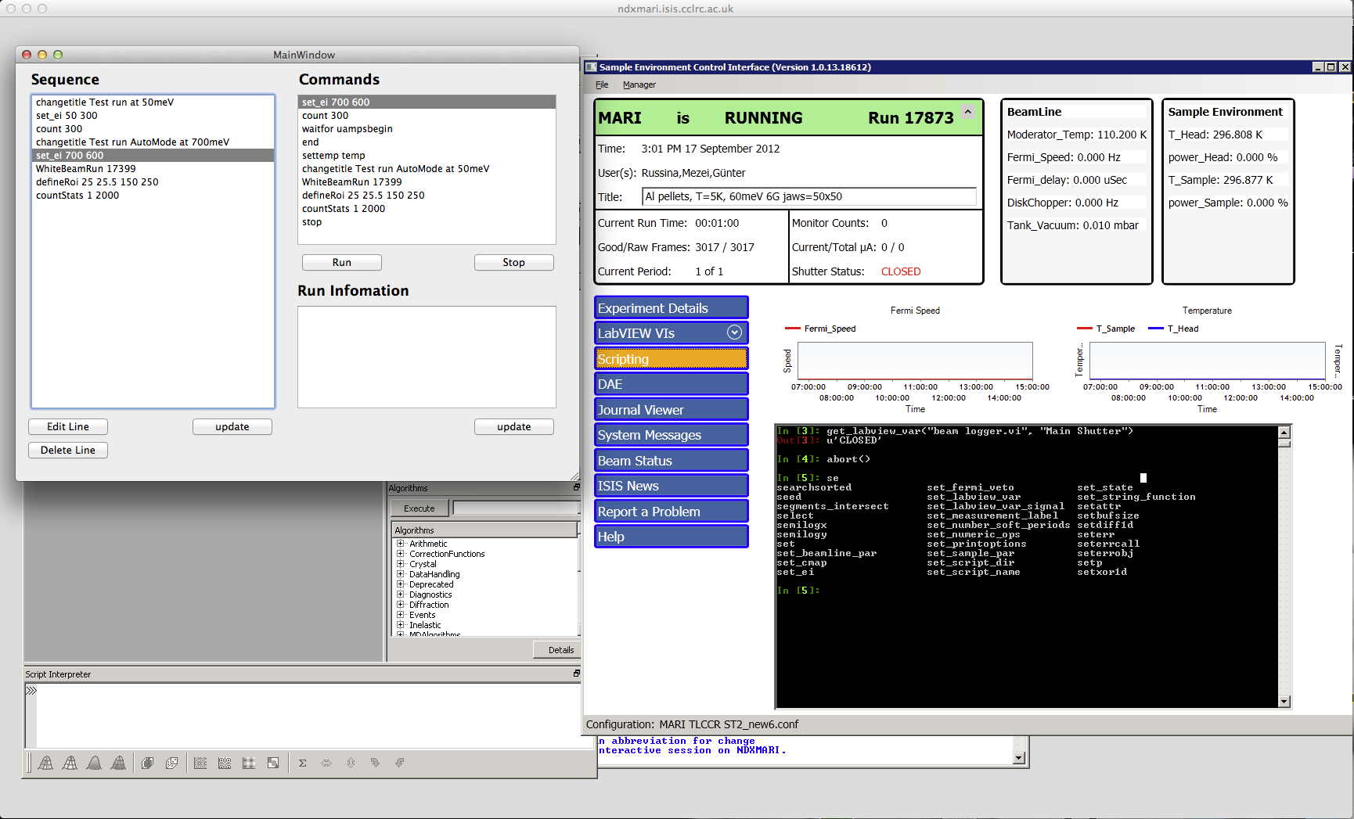
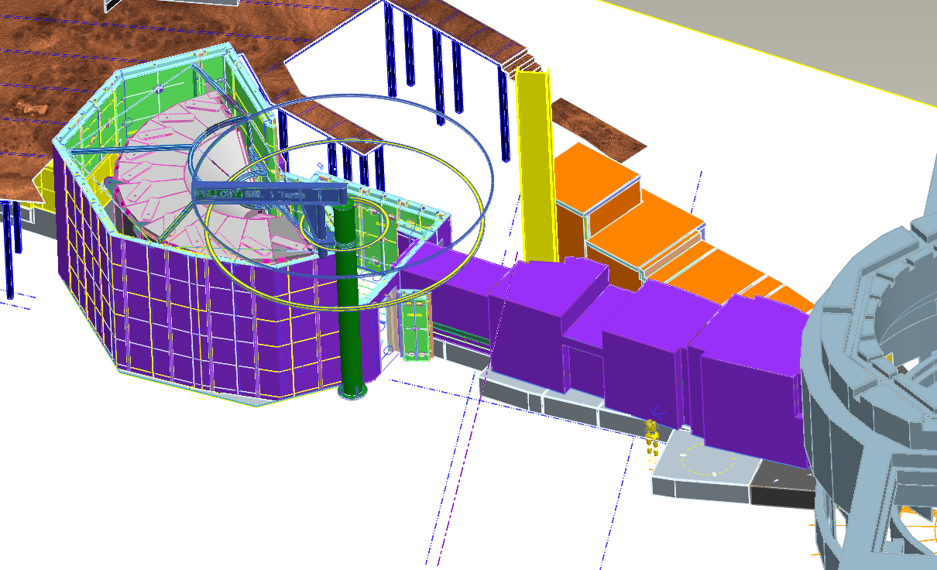
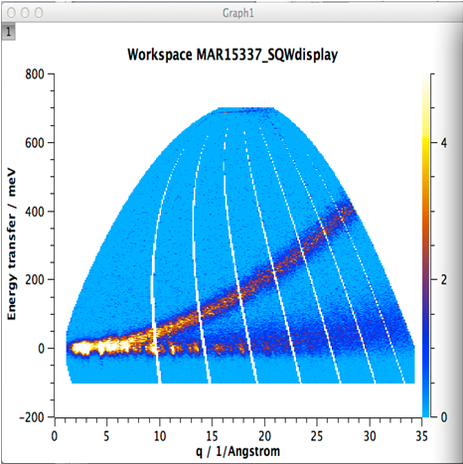
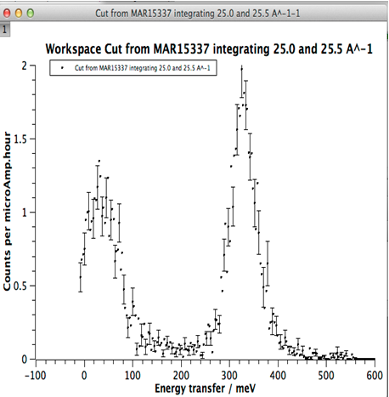
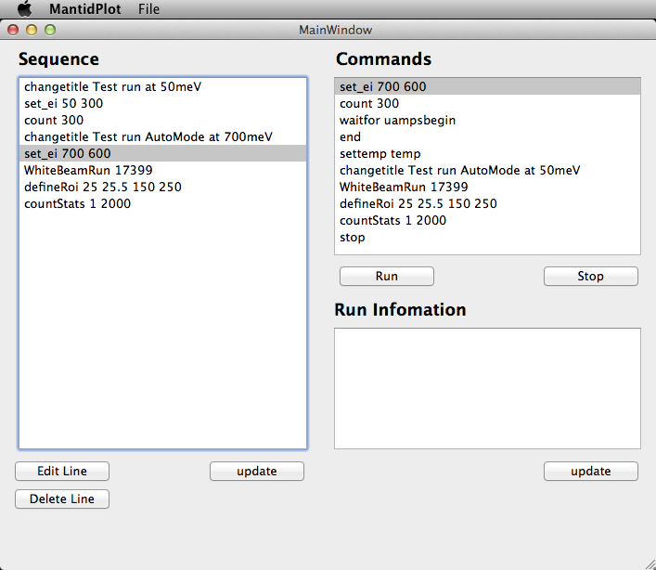



Linking instrument control with data analysis
Jon Taylor¹, Matt Clarke¹, Martyn Gigg²
¹ISIS facility STFC Rutherford Appleton Lab, Chilton, Oxfordshire, OX11 0QX
² Tessella plc, Abingdon, Oxfordshire, UK
Background
At most facilities the duration of a run is defined by an measuring for some quantity, such as elapsed time, frames or accumulated beam current. At the start of an experiment the individual run collection time is ‘guessed’. By looking at the data the collection time is iterated until an optimum is found, based flux sample mass etc. This iterative procedure often involves editing and reloading scripts which for the novice user is an opaque process.
The visiting scientist really wants to collect data until the statistics in an area of interest are good enough, then the experiment can move onto the next step without wasting valuable beam time.
The Mantid and PyGenie projects at ISIS provided an opportunity to combine their separate functionalities to allow intelligent control of experiments.
What we can do:
Interface with instrument control from python/ Ipython
Perform instrument control from Mantid
Begin(), End(), etc
Automate data reduction
Use reduced data error bars to control collection time ‘intelligent control’
Sequence instrument control with on the fly editing GUI
Customizable python command set
Used on MARI, Merlin, LET, MAPS
USER interface
Developer
PyGenie API
SECI API
Instrument control program → DAE
SECI → Sample environment & chopper control
NI LabView → device control
MantidPlot Python interface
SECI interface
Control these:
With this
To do this
Define Region of interest
Define error bar criteria
BEGIN Run
Features of GUI
Sequence and control instrument from within Mantidplot GUI
Current line of execution indicated by green colour
Edit sequence of commands during execution
No need to stop scripts and reload
Save and reload user sequences
Simple commands
Count 300 [count for 300 uamp integrated current]
DefineRoi 25 25.5 150 250 [define region of interest Qmin Qmax Emin Emax]
Set_ei 50 300 [set instrument incident energy to 50meV fermi chopper at 300Hz]
Settemp 20 [set the sample environment to 20K enable runcontrol +/-1K
Update from DAE & Reduce data to S(q,w)
Calculate statistic for ROI
Does statistic meet criteria
Drag and drop edited commands to generate sequence
NO
Run control by integrated current
YES
Intelligent run control
Waits for 1% errorbar on the defined ROI
Available commands
END run
Execute next line of sequence

